Slide 1
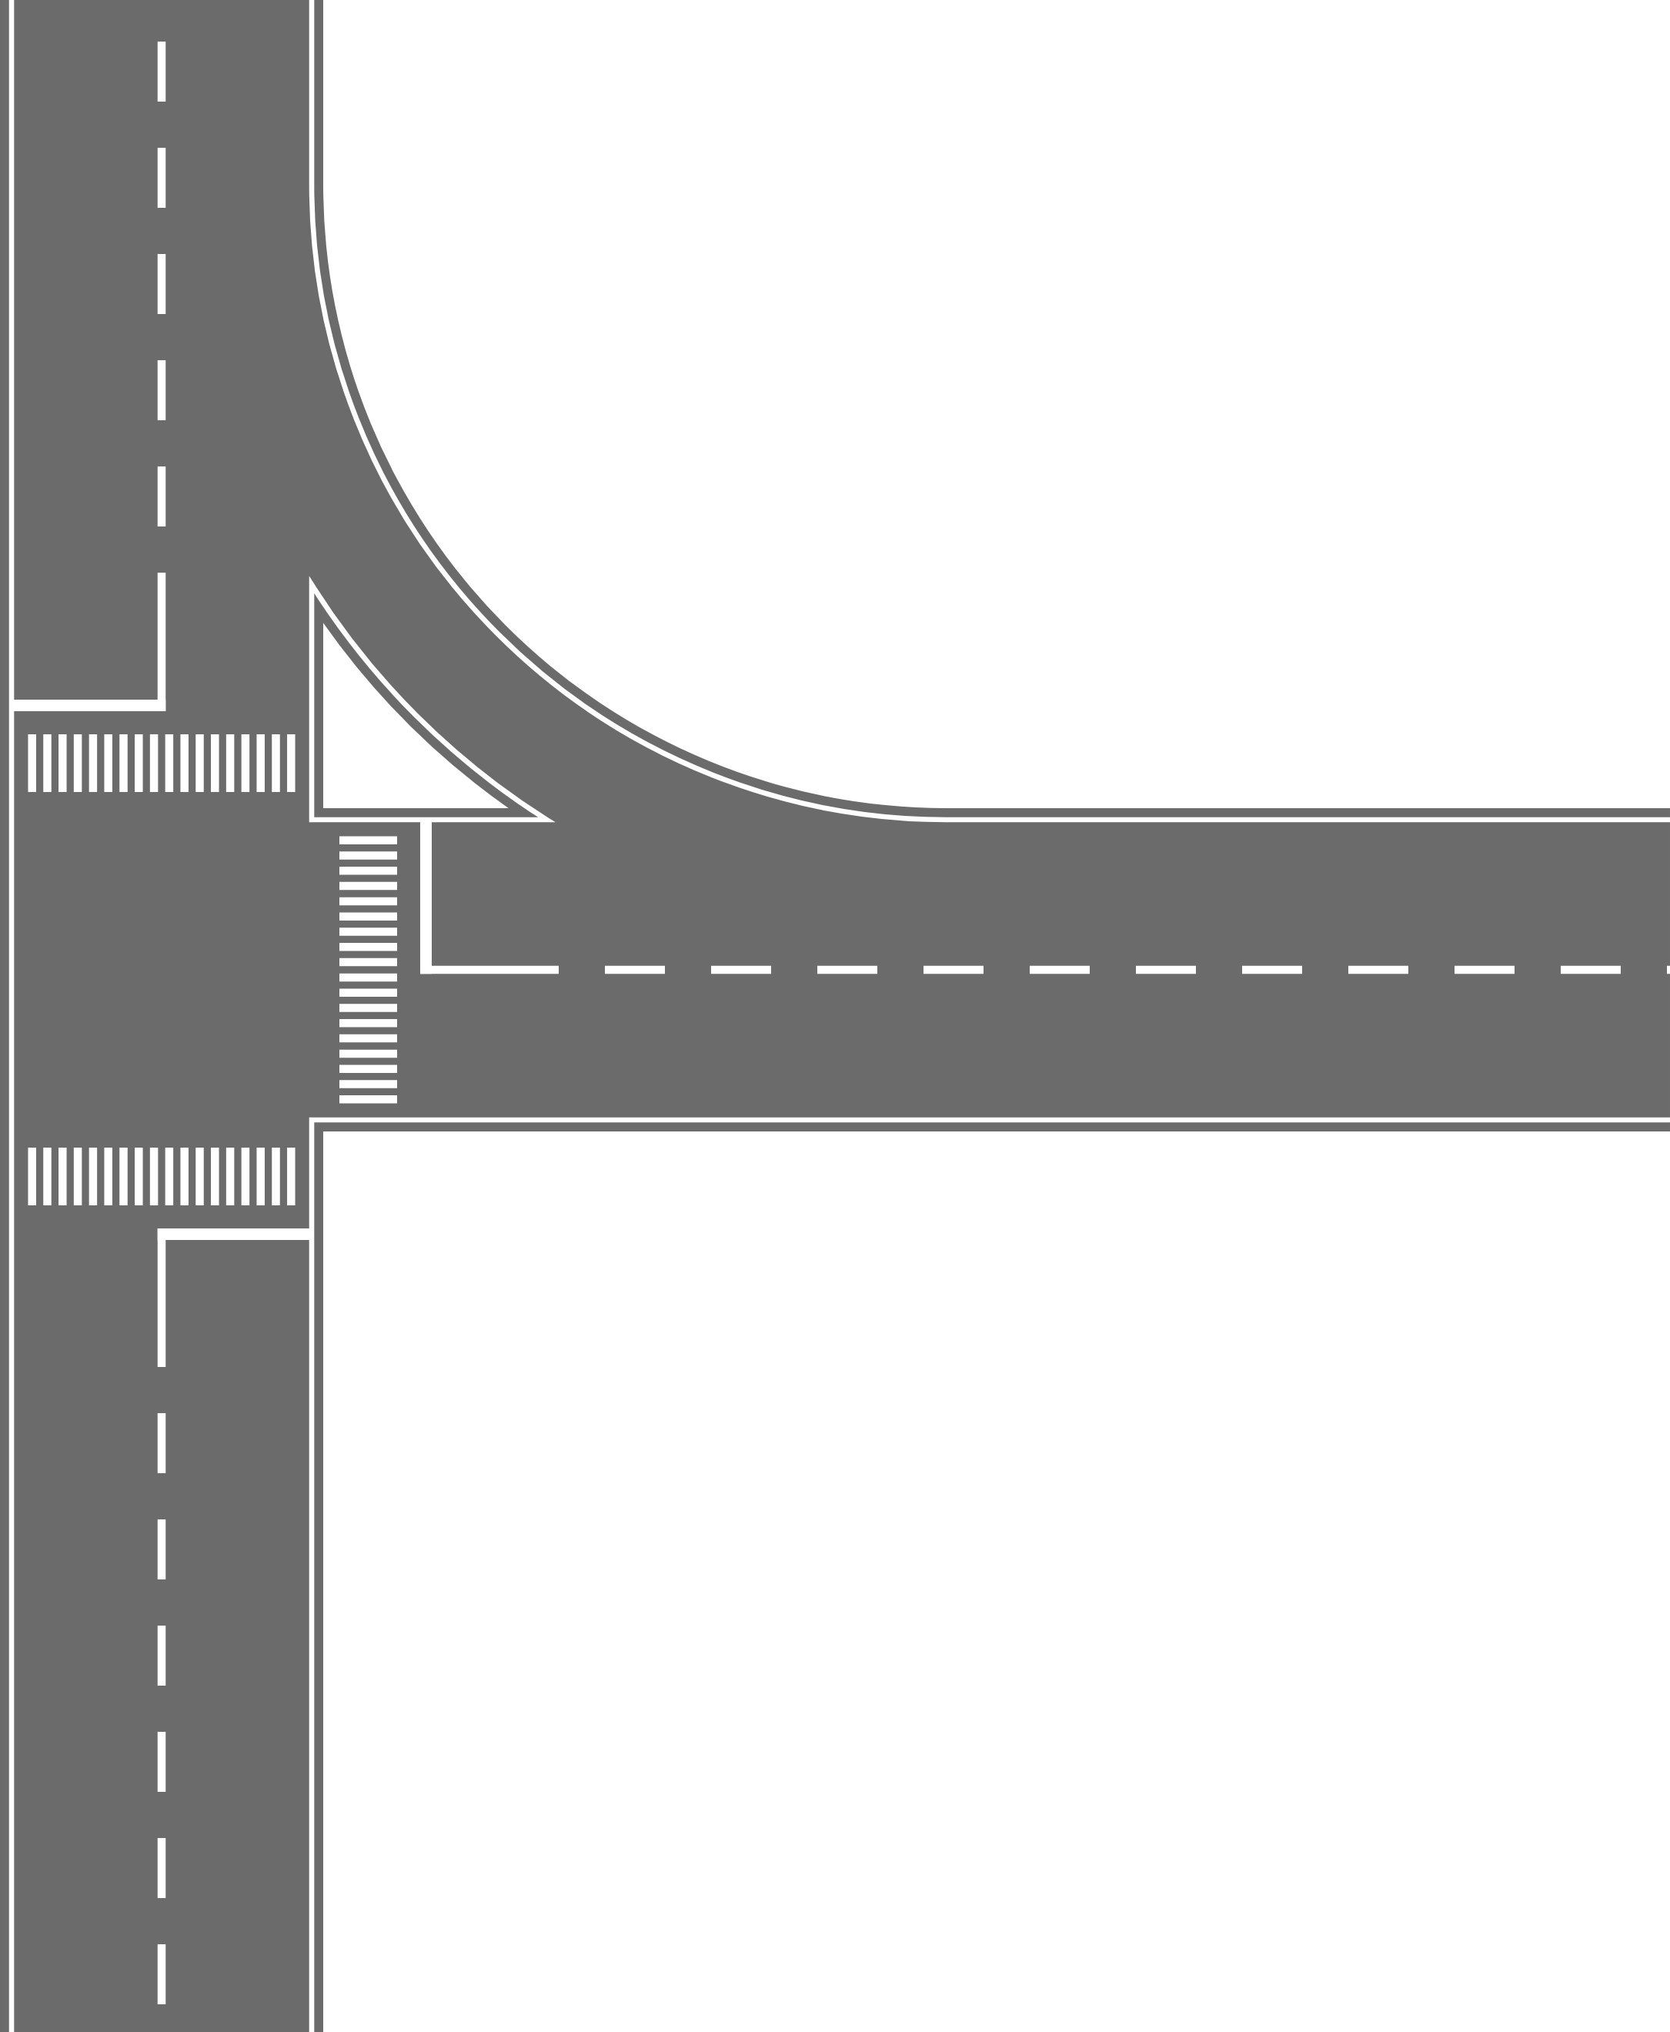
Traffic
Control
Simulator
Zane Dollarhide
Carson Page
Caden Palomares
Andrew Saigo

Slide 2
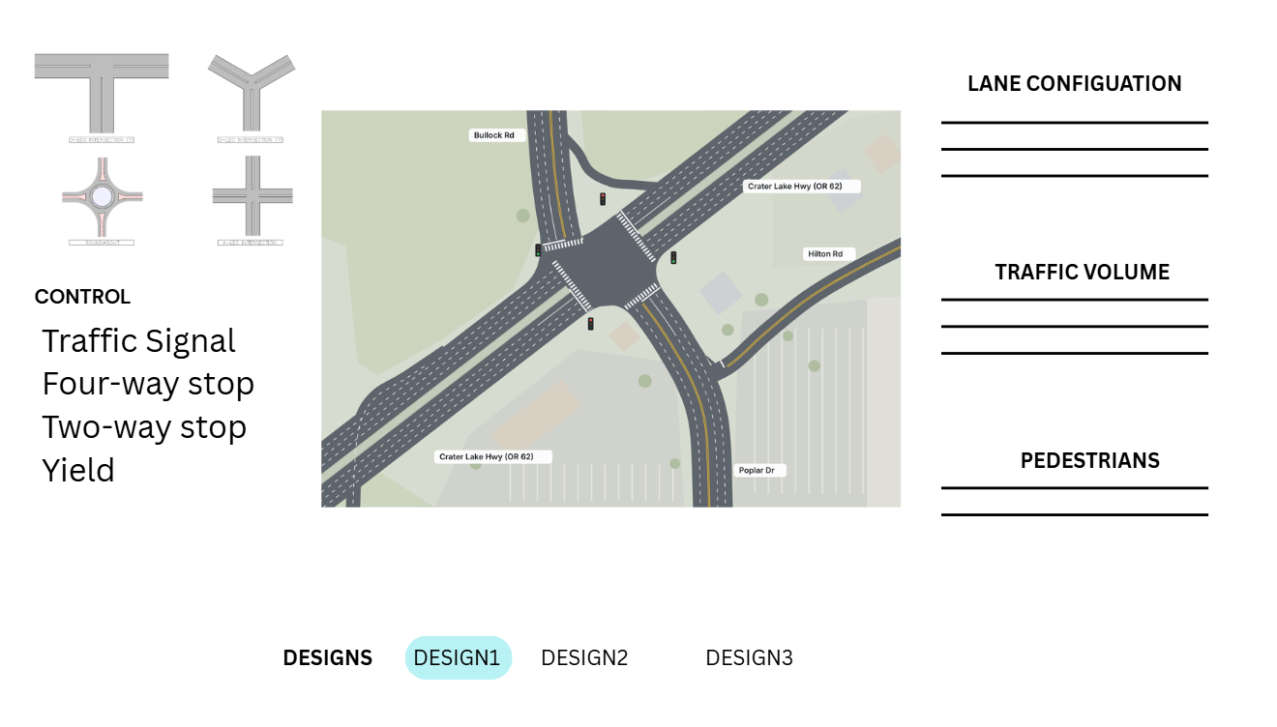
2d Intersection Builder
Users will be able to build an intersection by dragging and dropping components in the sandbox
4-way, Roundabouts, T-intersection, etc.
Signals, stop/yield signs
Configure lanes and speed limits

Slide 3
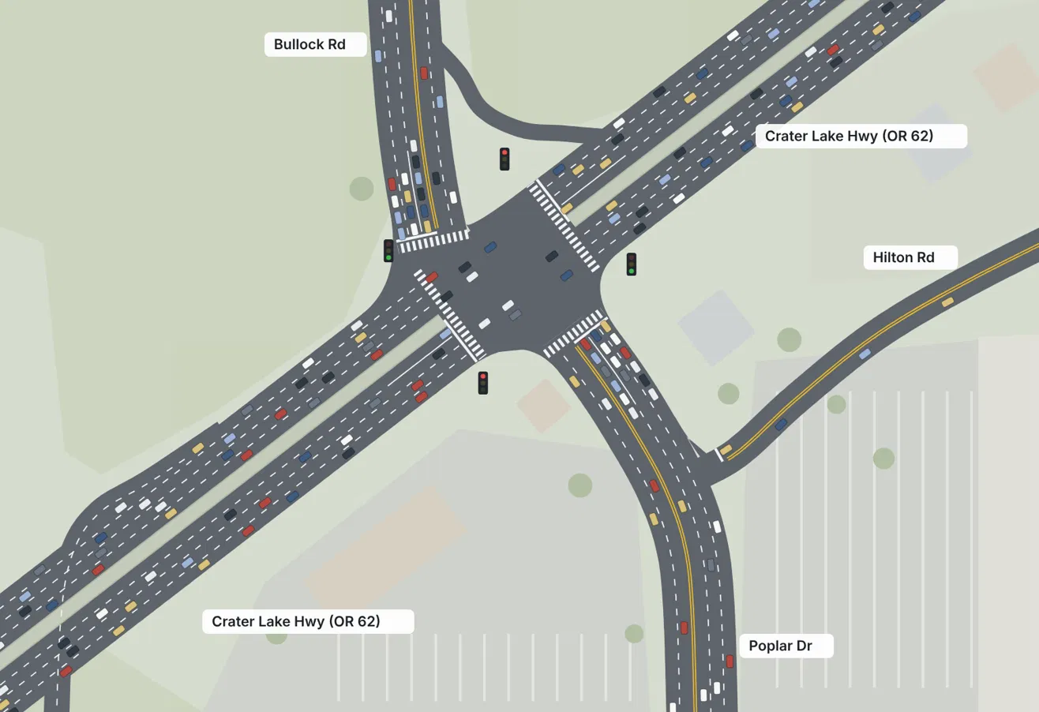
Vehicle simulation
Simulation shows individual cars moving through an intersection, allowing users to view how a design will handle traffic
Basic Driver Behavior Model
Variation between drivers
Cars abide by traffic rules
Adjustable simulation speed (1.0x, 2.0x)

Slide 4
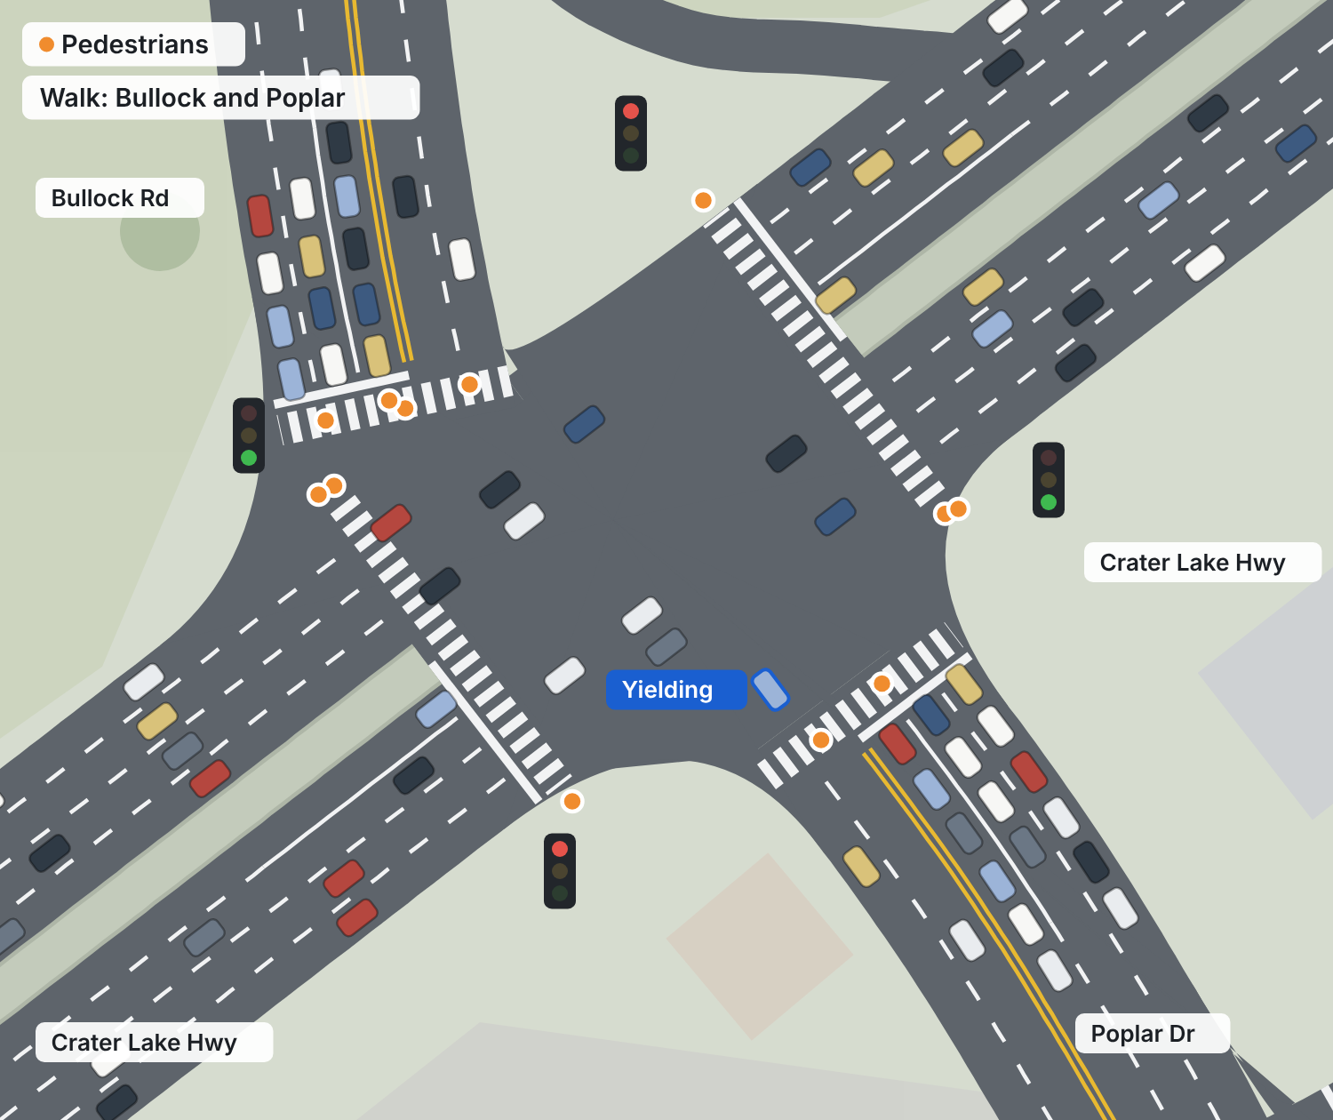
Basic pedestrian support
Pedestrians cross at marked crosswalks, allowing for designs to account for people walking as well
Cars yield to pedestrians
Crosswalks with pedestrian volume
Busier crosswalk leading to longer queues for turning cars

Slide 5
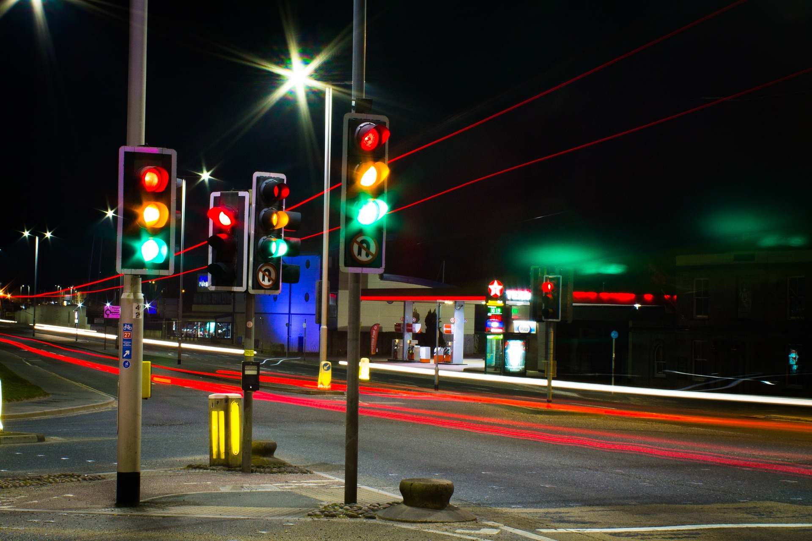
Signal timing controls
Users will be able to change the timing on traffic lights to better suit the intersection they are working on. These lights can be tested at different traffic densities and tested for the best efficiency.

Slide 6
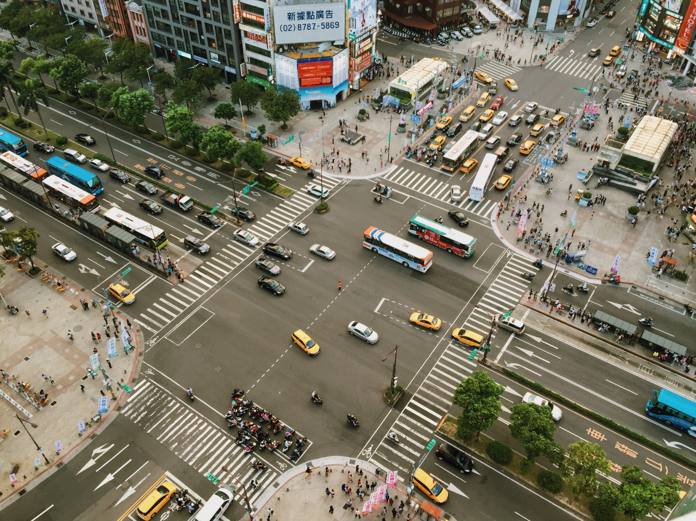
Adjustable traffic volume
Users will also be able to adjust the density of traffic going through the intersection to better simulate the stress the intersection will have.

Slide 7
Performance metrics
The simulation will be able to output performance metrics that show how well the intersection performed under varying amounts of load.
Possible metrics:
  Wait time
  Speed
  Number of vehicles through per amount of time
  Queue length

Slide 8
Input and output
Reference Images
  Generate from a bird’s-eye view picture of an intersection
  Insert an image to build on
Save Designs
  Simulation runs are saved with the design
  Compare designs and associated simulation results
Data Export
  Export simulation results to CSV

Slide 9
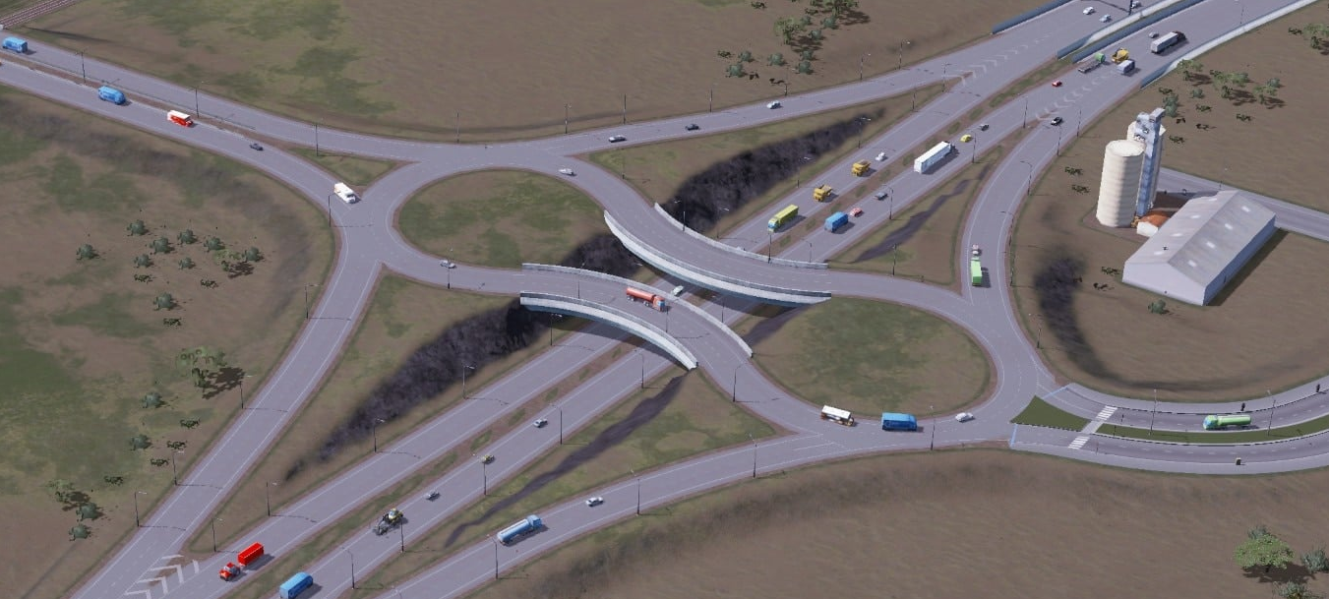
Stretch Goals: Part I
Layered Roads
Add Limited Elevation Control to Simulation
  Overpasses
  Underpasses
Useful for Highway Intersections
  Dogbone Interchange
Traffic Video Input
Analyze a Provided Video
  User Efficiency Tool
Determine Traffic Data
  Traffic Flow Directions
  Traffic Density
Alter Simulation Parameters to Match

Slide 10
Stretch Goals: Part II
Design Suggestions
Advanced Pedestrian Support
Algorithm Testing Common Intersections
  Intersection Types Predetermined
Uses Simulation Feature
Returns Best Resulting Intersection
More Than One Type of Actor
Differing Behavior
  Speed
  Awareness
  Caution

